Slide 1

Department of Computer Engineering
(01CE1702 – Artificial Intelligence)
(Unit : 3)
Knowledge Representation

Slide 2
Unit-3 Knowledge Representation
Outlines:
Representations And Mappings
Approaches To Knowledge Representation
Representation of Simple Facts In Logic
Representing Instance And Isa Relationships
Computable Functions and Predicates
Resolution
Procedural versus Declarative Knowledge
Logic Programming
Forward versus Backward Reasoning

Slide 3
Unit-3 Knowledge Representation
Outlines:
Representations And Mappings
Approaches To Knowledge Representation
Representation of Simple Facts In Logic
Representing Instance And Isa Relationships
Computable Functions and Predicates
Resolution
Procedural versus Declarative Knowledge
Logic Programming
Forward versus Backward Reasoning

Slide 4
Unit-3 Knowledge Representation
Data is viewed as collection of disconnected facts.
Information emerges when relationships among facts are established and understood.
Provides answers to "who", "what", "where", and "when".
Knowledge emerges when relationships among patterns are identified and understood. Provides answers as "how".

Slide 5
Unit-3 Knowledge Representation
In order to solve complex problems encountered in artificial intelligence, one needs both a large amount of knowledge and some mechanism for manipulating that knowledge to create solutions.
Knowledge and Representation are two distinct entities. They play central but distinguishable roles in the intelligent system.
Knowledge is a description of the world. It determines a system’s competence by what it knows.
Representation is the way knowledge is encoded. It defines a system’s performance in doing something.
The Knowledge Representation models/mechanisms are often based on:
◊ Logic ◊ Rules
◊ Frames ◊ Semantic Net

Slide 6
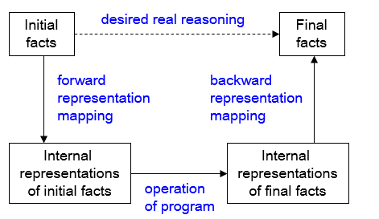
Representation & Mapping
Facts: things we want to represent.
Representations of facts: things we can manipulate
To derive a new information from old one (i.e to infer) mapping is required
map "facts to symbols" and "symbols to facts" using forward and backward representation mapping.

Slide 7
Unit-3 Knowledge Representation
Spot is a dog
Every dog has a tail
Spot has a tail
dog(Spot)
∀x: dog(x) → hastail(x)
hastail(Spot)

Slide 8
Unit-3 Knowledge Representation
Properties of Good representation:
Representational adequacy: The ability to represent all kinds of knowledge that are needed in that domain.
Inferential adequacy: The ability to manipulate the representational structures to derive new structures corresponding to new knowledge inferred from old.
Inferential efficiency: The ability to incorporate additional information into the knowledge structure that can be used to focus the attention of the inference mechanisms in the most promising direction.
Acquisition efficiency: The ability to acquire new knowledge using automatic methods wherever possible rather than reliance on human intervention.

Slide 9
Knowledge Representation Scheme
Relational Knowledge : The simplest way to represent declarative facts is as a set of relations of the same sort used in the database system.
Player | Height | Weight | Bats-Throws
Aaron | 6-0 | 180 | Right-Right
Varun | 5-10 | 170 | Right-Left
Akshay | 6-2 | 215 | Left-Left
Roger | 6-3 | 205 | Left-Right

Slide 10
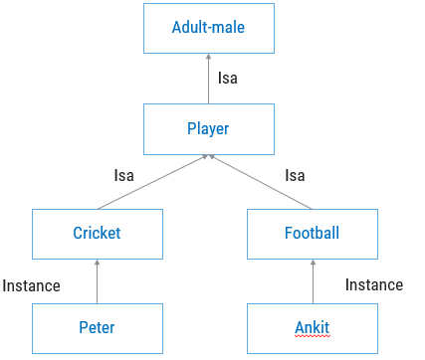
Unit-3 Knowledge Representation
Inheritable Knowledge : Here the knowledge elements inherit attributes from their parents.

Slide 11
Unit-3 Knowledge Representation
Inferential Knowledge : This knowledge generates new information from the given information. This new information does not require further data gathering form source, but does require analysis of the given information to generate new knowledge.
Example:
Given a set of relations and values, one may infer other values or relations.
A predicate logic (a mathematical deduction) is used to infer from a set of attributes.
Inference through predicate logic uses a set of logical operations to relate individual data.
Represent knowledge as formal logic:
All dogs have tails :: ∀x: dog(x) → hastail(x)

Slide 12
Representation of simple facts
Logic
The logical formalism of a language is useful because it immediately suggests a powerful way of deriving new knowledge from old using mathematical deduction.
In this formalism, we can conclude that a new statement is true by proving that it follows from the statements that are already known.
Proposition
A proposition is a statement, or a simple declarative sentence.
For example, “the book is expensive” is a proposition.
A proposition can be either true or false
A proposition formula which is always true is called tautology, and it is also called a valid sentence.
A proposition formula which is always false is called Contradiction.

Slide 13
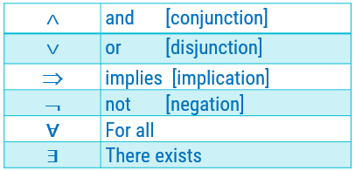
Propositional Logic
Logical constants: true, false
Propositional symbols: P, Q, S,... (atomic sentences)
Propositions are combined by connectives:

Slide 14
Propositional Logic
Representing simple facts using propositional logic:
It is raining
RAINING
It is sunny
SUNNY
It is windy
WINDY
If it is raining, then it is not sunny
RAINING SUNNY

Slide 15
Predicate Logic
First-order Predicate logic (FOPL) is a formal language in which propositions are expressed in terms of predicates, variables and quantifiers.
It is different from propositional logic which lacks quantifiers.
It should be viewed as an extension to propositional logic, in which the notions of truth values, logical connectives, etc. still apply but propositional letters will be replaced by a newer notion of proposition involving predicates and quantifiers.
A predicate is an expression of one or more variables defined on some specific domain.
A predicate with variables can be made up of a proposition by either assigning a value to the variable or by quantifying the variable.

Slide 16
Well formed Formula
Well Formed Formula (wff) is a predicate holding any of the following −
All propositional constants and propositional variables are wffs
If x is a variable and Y is a wff, ∀Y and ∃x are also wff
Truth value and false values are wffs
Each atomic formula is a wff
All connectives connecting wffs are wffs

Slide 17
Well formed Formula
1. Marcus was a man.
2. Marcus was a Pompeian.
3. All Pompeians were Romans.
4. Caesar was a ruler.
5. All Pompeians were either loyal to Caesar or hated him.
man(Marcus)
Pompeian(Marcus)
∀ x: Pompeian(x) → Roman(x)
ruler(Caesar)
∀x: Roman(x) → loyalto(x, Caesar) ∨ hate(x, Caesar)

Slide 18
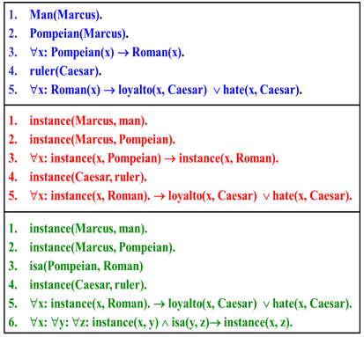
Representing ISA relationship
Specific attributes instance and isa play important role particularly in a useful form of reasoning called property inheritance.
The predicates instance and isa explicitly captured the relationships they are used to express, namely class membership and class inclusion.
The predicate instance is a binary one, whose first argument is an object and whose second argument is a class to which the object belongs.
The use of the isa predicate simplifies the representation of sentence 3, but it requires that one additional axiom (shown here as number 6) be provided.

Slide 19
Well formed Formula
1. Marcus was a man.
2. Marcus was a Pompeian.
3. Marcus was born in 40 A.D.
4. All Pompeians died when the volcano erupted in 79 A.D
5. Alive means not dead.
man(Marcus)
Pompeian(Marcus)
born(Marcus,40)
erupted(volcano,79) /\ ∀x: Pompeian(x) → died(x,79)
∀x ∀t: [alive(x,t) → ~dead(x,t)] /\ [~dead(x,t) →alive(x,t)]

Slide 20
Knowledge Representation
Suppose we want to answer the question “Is Marcus alive now?”. We can do this by either
proving alive(Marcus,now) or ~alive(Marcus,now). Let us try the latter:
~alive(Marcus,now)
↓ 8
~[~dead(Marcus,now)]
↓ negation operation
dead(Marcus,now)
↓ 9
died(Marcus,t1) /\ gt(now,t1)
↓ 5
erupted(volcano,79) /\ Pompeian(Marcus) /\ gt(now,79)
↓fact, 2
gt(now,79)
↓
gt(1991,79)
↓ compute gt
nil

Slide 21
Forward Reasoning
Forward reasoning is a process in artificial intelligence that finds all the possible solutions of a problem based on the initial data and facts. Thus, the forward reasoning is a data-driven task as it begins with new data. The main objective of the forward reasoning in AI is to find a conclusion that would follow.
Forward reasoning flows from incipient to the consequence. The inference engine searches the knowledge base with the given information depending on the constraints. The precedence of these constraints have to match the current state.
In forward reasoning, the first step is that the system is given one or more constraints. The rules are then searched for in the knowledge base for every constraint. The rule that fulfils the condition is selected. Also, every rule can generate a new condition from the conclusion which is obtained from the invoked one. This new conditions can be added and are processed again.
The step ends if no new conditions exist. Hence, we can conclude that forward reasoning follows the top-down approach.

Slide 22
Backward Reasoning
Backward reasoning is the reverse process of the forward reasoning in which a goal or hypothesis is selected and it is analyzed to find the initial data, facts, and rules. Therefore, the backward reasoning is a goal driven task as it begins with conclusions or goals that are uncertain. The main objective of the backward reasoning is to find the facts that support the conclusions.
Backward reasoning uses a conservative type of approach and flows from consequence to the incipient. The system helps to choose a goal state and reasons in a backward direction. The first step in the backward reasoning is that the goal state and rules are selected. Then, sub-goals are made from the selected rule, which need to be satisfied for the goal state to be true.
Backward reasoning is also known as a decision-driven or goal-driven inference technique because the system selects a goal state and reasons in the backward direction.

Slide 23
Resolution
Resolution is a procedure, which gains its efficiency from the fact that it operates on statements that have been converted to a very convenient standard form.
Resolution produces proofs by refutation.
In other words, to prove a statement (i.e., to show that it is valid), resolution attempts to show that the negation of the statement produces a contradiction with the known statements (that it is un-satisfiable).
The resolution procedure is a simple iterative process: at each step, two clauses, called the parent clauses, are compared (resolved), resulting into a new clause that has been inferred from them.
The new clause represents ways that the two parent clauses interact with each other.
(-) Negative + Negative (-) = Positive (+)

Slide 24
Resolution
Suppose we know:
winter ∨ summer
¬winter
summer
---------------------
¬summer
nil
winter ∨ summer
¬winter ∨ cold
------------------------
summer ∨ cold

Slide 25
Reference Book
Artificial Intelligence – Kevin Knight and Elaine Rich

Slide 26


